Slide 1

Azure Data Factory
TRAINER
Maruti Makwana
DATE
8th Sept 2025

Slide 2
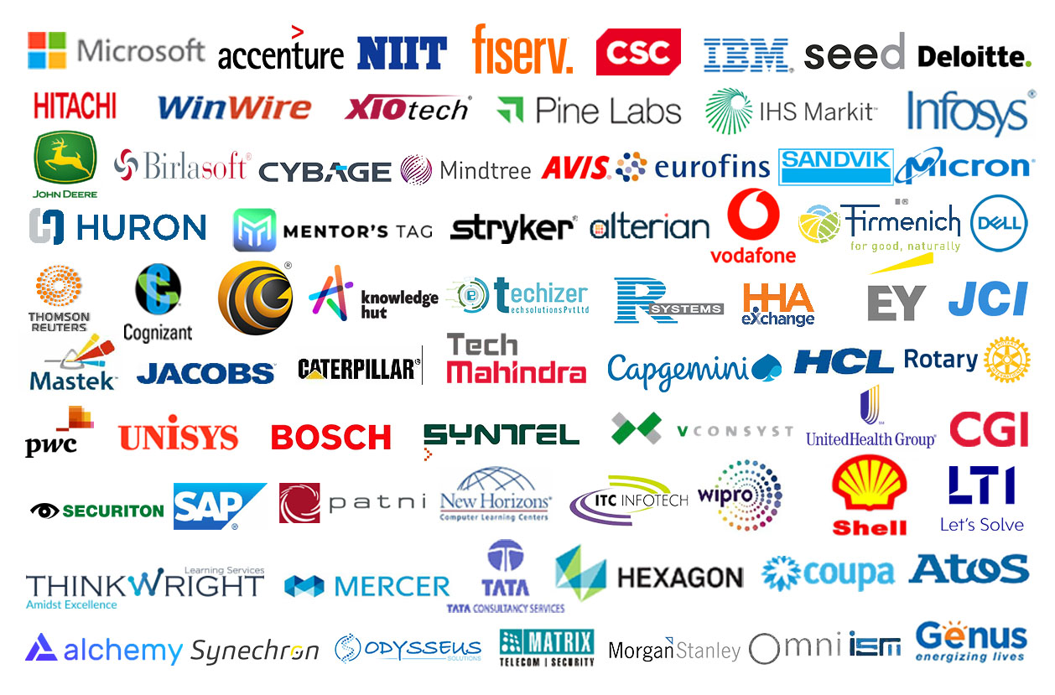
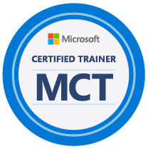
Maruti
Makwana

Slide 3
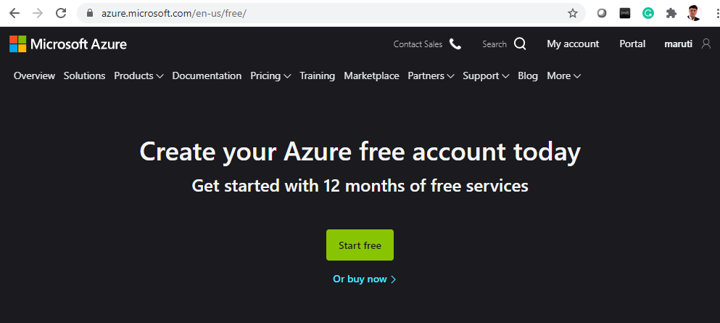
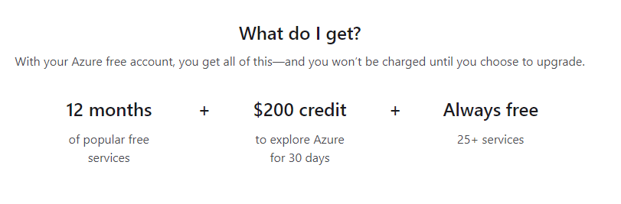
Prerequisites
Get your
Azure Subscription
Today
Notes:
https://azure.microsoft.com/en-us/free/

Slide 4
Azure
Database
Data Lake
Synapse
Datacenter
Geo Replication
Delta Lake
Notebooks
IAAS
Databricks
Data flow
PAAS
Streaming
BLOB
Data Factory
Key Vault

Slide 5
IAAS – PAAS - SAAS
On-Premises
( Private Cloud )
Infrastructure
( as a Service )
Platform
( as a Service )
Software
( as a Service )
Data & Access
Data & Access
Data & Access
Data & Access
Applications
Applications
Applications
Applications
You Manage
Runtime
Runtime
Runtime
Runtime
Cloud Provider Manages
Operating System
Operating System
Operating System
Operating System
Virtual Machine
Virtual Machine
Virtual Machine
Virtual Machine
Compute
Compute
Compute
Compute
Networking
Networking
Networking
Networking
Storage
Storage
Storage
Storage

Slide 6
SLAs for Azure products and services
Performance targets are expressed as uptime and connectivity guarantees.
Performance-targets range from 99.9% (three nines) to 99.99% (four nines).
If a service fails to meet the guarantees, a percentage of the monthly service fees can be credited to you.
SLA | Downtime per month | Downtime per year
99.9% | 43.2 minutes | 8.76 hours
99.95 | 21.6 minutes | 4.38 hours
99.99 | 4.32 minutes | 52.56 minutes
Notes:
You might want to browse to some SLA’s directly https://azure.microsoft.com/en-us/support/legal/sla/summary/ and explore one or two as examples.

Slide 7
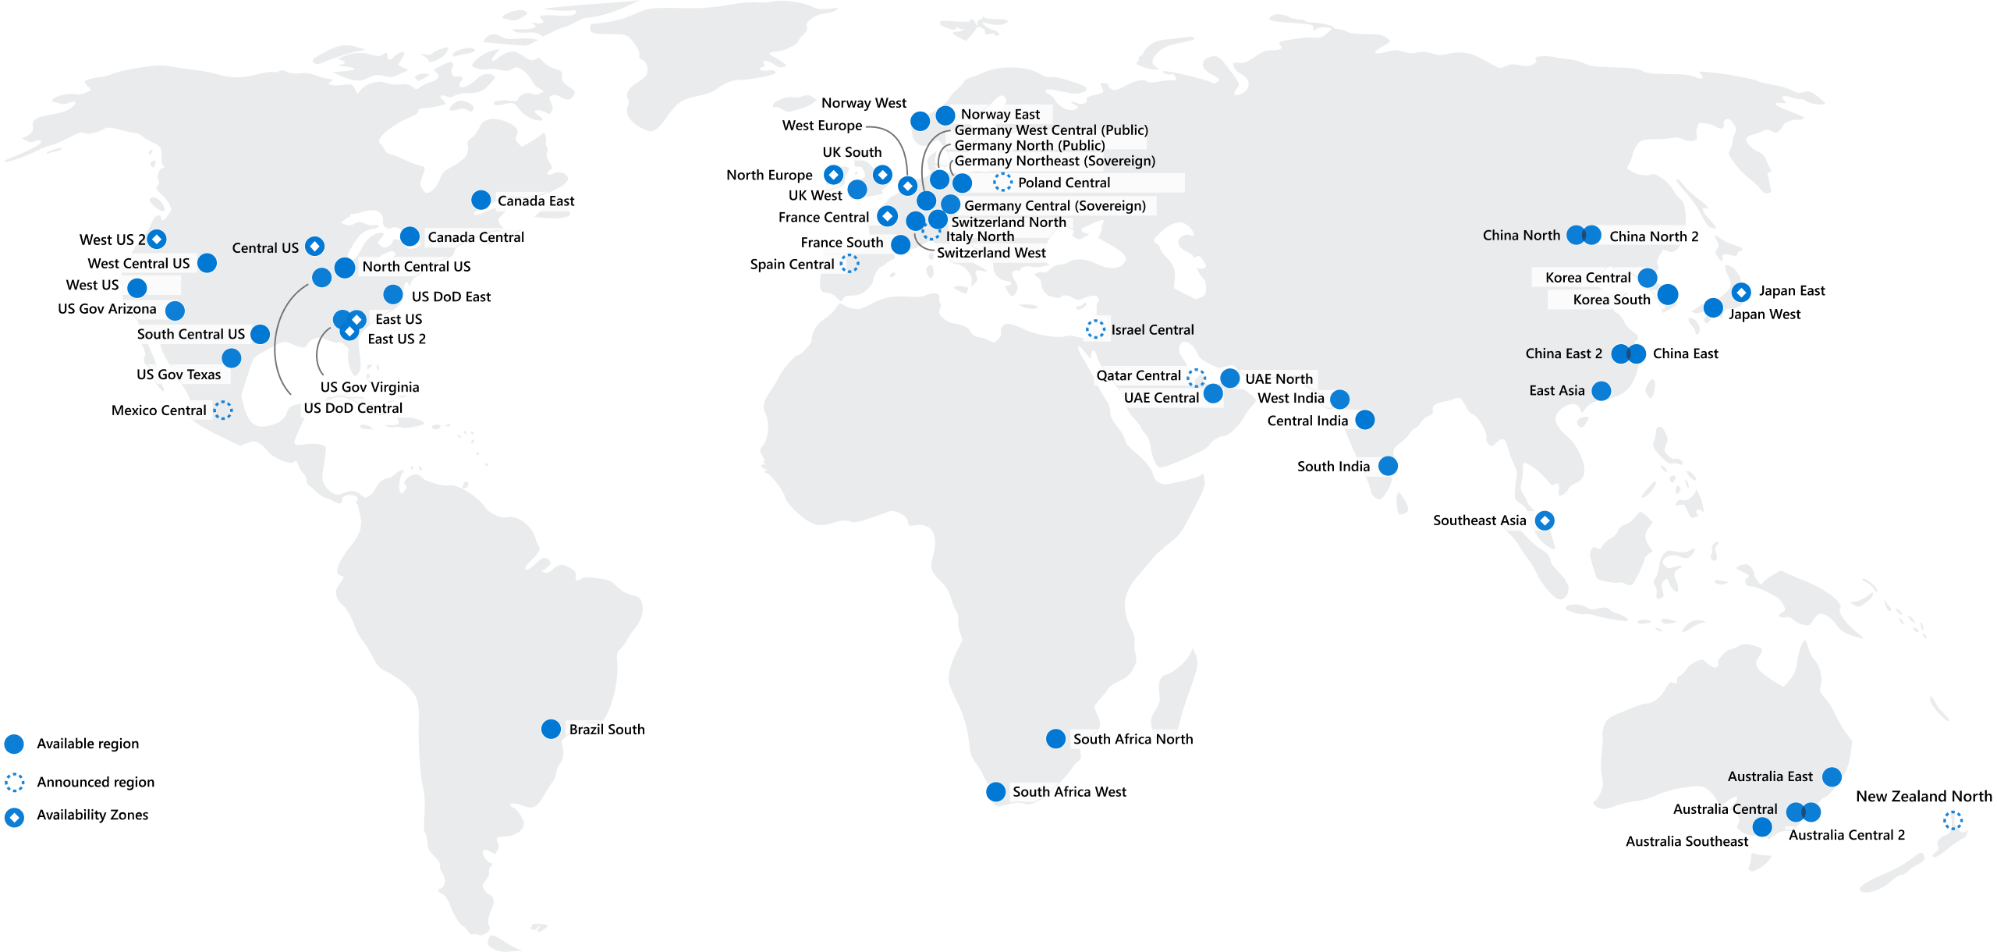
Regions
Azure offers more global regions than any other cloud provider with 60+ regions representing over 140 countries
Regions are made up of one or more datacenters in close proximity.
Provide flexibility and scale to reduce customer latency.
Preserve data residency with a comprehensive compliance offering.
Notes:
A region represents a collection of datacenters.
Provide flexibility and scale.
Preserve data residency.
Select regions close to your users.
Be aware of region deployment availability.
There are global services that are region independent.
A list of regions and their locations is available at https://azure.microsoft.com/en-us/global-infrastructure/locations/
Learn and SkillPipe content order note:
Slides 6-10
https://docs.microsoft.com/en-us/learn/modules/azure-architecture-fundamentals/regions-availability-zones

Slide 8



Azure storage services
Container storage (blob) is optimized for storing massive amounts of unstructured data, such as text or binary data.
Disk storage provides disks for virtual machines, applications, and other services to access and use.
Azure Files sets up a highly available network file shares that can be accessed by using the standard Server Message Block (SMB) protocol.
Notes:
Storage services - https://azure.microsoft.com/en-us/product-categories/storage/
Learn and SkillPipe content order note:
Multiple Learn units cover the content in this slide
https://docs.microsoft.com/en-us/learn/modules/azure-storage-fundamentals/introduction
https://docs.microsoft.com/en-us/learn/modules/azure-storage-fundamentals/azure-storage-accounts
https://docs.microsoft.com/en-us/learn/modules/azure-storage-fundamentals/azure-disk-storage
https://docs.microsoft.com/en-us/learn/modules/azure-storage-fundamentals/azure-blob-container-storage
https://docs.microsoft.com/en-us/learn/modules/azure-storage-fundamentals/azure-file-storage

Slide 9




Azure database services
Azure Cosmos Database is a globally-distributed database service that elastically and independently scales throughput and storage.
Azure SQL Database is a relational database as a service (DaaS) based on the latest stable version of the Microsoft SQL Server database engine.
Azure Database for MySQL is a fully-managed MySQL database service for app developers.
Azure Database for PostgreSQL is a relational database service based on the open-source Postgres database engine.
© Copyright Microsoft Corporation. All rights reserved.
Notes:
✔️ These are just a few of our database service offerings. Take a minute to review other database services and [find the product you need](https://azure.microsoft.com/en-us/product-categories/databases/).
Azure Cosmos DB - https://azure.microsoft.com/en-us/services/cosmos-db/
Azure SQL Database - https://azure.microsoft.com/en-us/services/sql-database/
Learn and SkillPipe content order note:
Multiple Learn units cover the content in this slide
https://docs.microsoft.com/en-us/learn/modules/azure-database-fundamentals/introduction
https://docs.microsoft.com/en-us/learn/modules/azure-database-fundamentals/azure-cosmos-db
https://docs.microsoft.com/en-us/learn/modules/azure-database-fundamentals/azure-sql-database
https://docs.microsoft.com/en-us/learn/modules/azure-database-fundamentals/azure-mysql-database
https://docs.microsoft.com/en-us/learn/modules/azure-database-fundamentals/azure-postgresql-database

Slide 10
Cloud Models
Public cloud:
No capital expenditures to scale up.
Applications can be quickly provisioned and deprovisioned.
Organizations pay only for what they use.
Private cloud:
Organizations have complete control over resources.
Organizations have complete control over security.
Hybrid cloud:
Most flexibility.
Organizations determine where to run their applications.
Organizations control security, compliance, or legal requirements.

Slide 11
Region Pairs
Region
North Central US​
East US​
West US 2​
US East 2​
Canada Central​
North Europe​
UK West​
Germany Central​
South East Asia​
East China​
Japan East​
Australia Southeast​
India South​
Brazil South (Primary)​
Region
South Central US​
West US​
West Central US​
Central US​
Canada East​
West Europe​
UK South​
Germany Northeast​
East Asia​
North China​
Japan West​
Australia East​
India Central​
South Central US ​
At least 300 miles of separation between region pairs.
Automatic replication for some services.
Prioritized region recovery in the event of outage.
Updates are rollout sequentially to minimize downtime.
Web Link: https://aka.ms/PairedRegions
Notes:
Each Azure region is paired with another region.
Azure prefers at least 300 miles of separation between datacenters in a regional pair.
Some services provide automatic replication to the paired region.
In an outage, recovery of one region is prioritized out of every pair.
Azure system updates are rolled out to paired regions sequentially (not at the same time).
List of geographies, regions, region-pairs, and other details -https://azure.microsoft.com/en-us/global-infrastructure/geographies/
A full list of region pairs is available at https://docs.microsoft.com/en-us/azure/best-practices-availability-paired-regions#what-are-paired-regions
Learn and SkillPipe content order note:
Slides 6-10
https://docs.microsoft.com/en-us/learn/modules/azure-architecture-fundamentals/regions-availability-zones

Slide 12
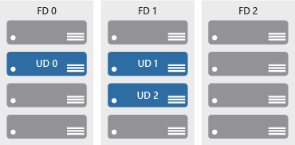

Define Availability zones
Azure Region
Availability Zone 1
Availability Zone 2
Physically separate locations within an Azure region.
Includes one or more datacenters, equipped with independent power, cooling, and networking.
If one availability zone goes down, the other continues working.
Availability Zone 3
Notes:
More details about Availability Zones in Azure are available at https://docs.microsoft.com/en-us/azure/availability-zones/az-overview
Physically separate locations within an Azure region.
Takes availability sets to the next level
Includes one or more datacenters, equipped with independent power, cooling, and networking.
Acts as an isolation boundary.
If one availability zone goes down, the other continues working.

Slide 13






Azure Management Tools
Azure portal
Azure PowerShell and Azure Command-Line Interface (CLI)
Azure Cloud Shell
Azure mobile app
Azure REST API

Slide 14
Azure Storage Overview
Disks
Storage Accounts
Persistent disks for Azure IaaS VMs
Premium storage disk options
Files
Fully managed file shares in the cloud
SMB and REST access
"Lift and shift" legacy apps
Sync with on-premises
Blobs
Highly scalable, REST-based cloud object store
Block blobs: Sequential file I/O
Page blobs: Random-write pattern data
Append blobs
Tables
Massive auto-scaling NoSQL store
Dynamic scaling based on load
Queues
Reliable queues at scale for cloud services
Decouple and scale components
Message visibility
Durability, Encryption at Rest, Strongly Consistent Replication, Fault Tolerance, Auto Load-Balancing

Slide 15
Storage Account replication
Single region
Multiple regions
Typically >300mi
Typically >300mi
Z1
Z2
Z3
Async
Async
Primary
Secondary
Primary
Secondary
LRS
Three replicas, one region
Protects against disk, node, rack failures
Write is acknowledged when all replicas are committed
Superior to dual-parity RAID
ZRS
Three replicas, three zones, one region
Protects against disk, node, rack, and zone failures
Synchronous writes to all three zones
RA-GRS
GRS + read access to secondary
Separate secondary endpoint
Recovery point objective (RPO) delay to secondary can be queried
GRS
Six replicas, two regions (three per region)
Protects against major regional disasters
Asynchronous copy to secondary

Slide 16
Storage Account replication
Multiple regions
Z1
Typically >300mi
Z1
Typically >300mi
Z2
Z3
Z2
Z3
Async
Async
Secondary
Secondary
GZRS
Six replicas, 3+1 zones, two regions
Protects against disk, node, rack, zone, and region failures
Synchronous writes to all three zones and asynchronous copy to secondary
RA-GZRS
GZRS + read access to secondary
Separate secondary endpoint
RPO delay to secondary can be queried

Slide 17
Azure Data Lake storage – ADLS Gen2
Notes:
Instructor notes
This space has been left deliberately blank

Slide 18
What is Data Lake?
A Data Lake is a storage repository that can store large amount of structured, semi-structured, and unstructured data. It is a place to store every type of data in its native format with no fixed limits on account size or file. It offers high data quantity to increase analytic performance and native integration.
Data Lake is like a large container which is very similar to real lake and rivers. Just like in a lake you have multiple tributaries coming in, a data lake has structured data, unstructured data, machine to machine, logs flowing through in real-time.

Slide 19
Processing Big Data with Azure Data Lake Store
1. Ingestion
2. Store
4. Model & serve
3. Prep & train
Notes:
Talking points
There are four stages for processing big data solutions that are common to all architectures:
Ingestion - The ingestion phase identifies the technology and processes that are used to acquire the source data. This data can come from files, logs, and other types of unstructured data that must be put into the Data Lake Store. The technology that is used will vary depending on the frequency that the data is transferred. For example, for batch movement of data, Azure Data Factory may be the most appropriate technology to use. For real-time ingestion of data, Apache Kafka for HDInsight or Stream Analytics may be an appropriate technology to use.
Store - The store phase identifies where the ingested data should be placed. In this case, we're using Azure Data Lake Storage Gen2.
Prep and train - The prep and train phase identifies the technologies that are used to perform data preparation and model training and scoring for data science solutions. The common technologies that are used in this phase are Azure Databricks, Azure HDInsight or Azure Machine Learning Services.
Model and serve - Finally, the model and serve phase involves the technologies that will present the data to users. These can include visualization tools such as Power BI, or other data stores such as Azure Synapse Analytics, Azure Cosmos DB, Azure SQL Database, or Azure Analysis Services. Often, a combination of these technologies will be used depending on the business requirements.
Instructor notes and guidance
This diagram represent the four-step process for processing data for big data analytics solutions that prepare for Machine Learning projects. The data engineer would be involved with the ingestion and storage stage and will touch on aspects of the preparation steps in phase 3. The remaining steps are typically performed by a data scientist
Recommended reading for this slide
https://docs.microsoft.com/en-us/learn/modules/introduction-to-azure-data-lake-storage/5-stages-for-processing-big-data

Slide 20
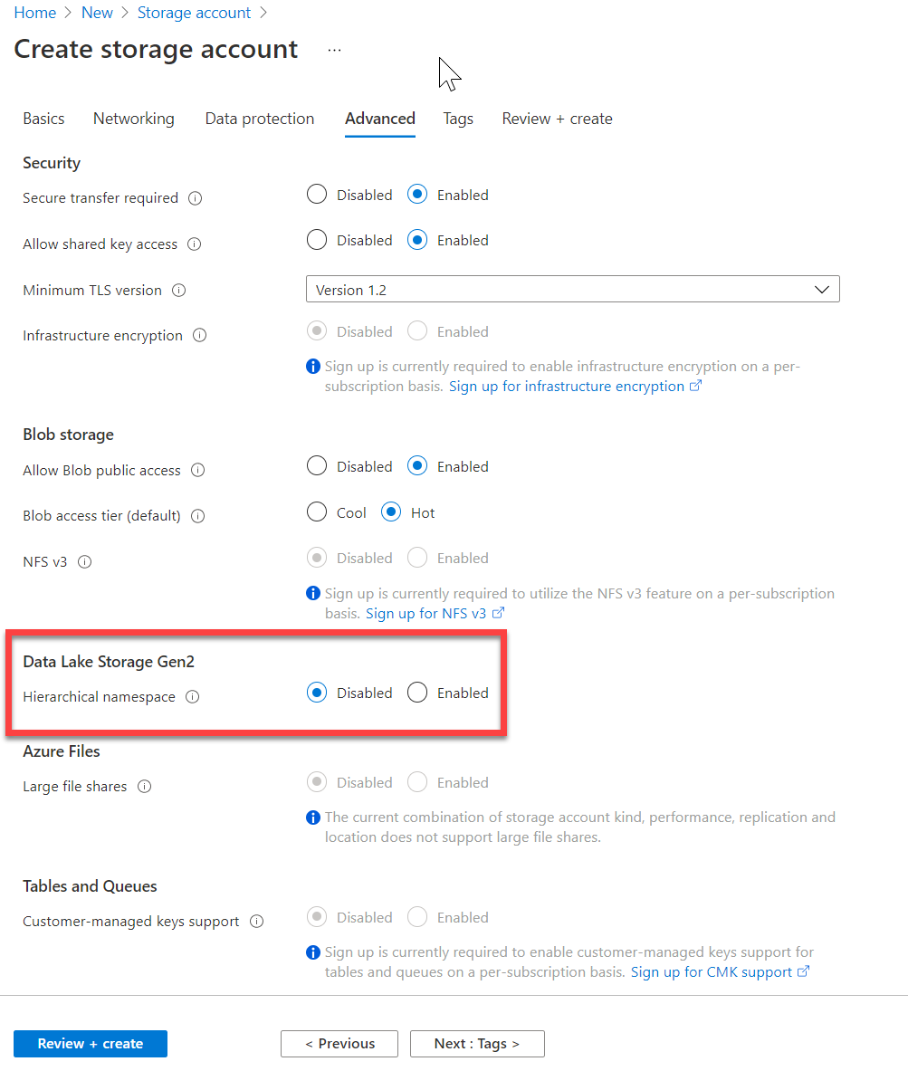
Introduction to Azure Data Lake storage
Hadoop compatible
Security
Performance
Redundancy
Notes:
Talking points
The first point of “Hadoop Access” is a key differentiator for using Azure Data Lake Storage Gen2 (ADLSG2) over Blob storage. Coupled with the security model that provides very granular permissions, this makes ADLSG2 a compelling data storage tier for a range of Azure data platform technologies including Azure Synapse and Azure Databricks. The ability to perform big data analytics is critical and the performance of ADLSG2 helps with that performance. All of this comes with the Geo redundancy capability to ensure that the data is safe.
Instructor notes and guidance
This will be the only module where we cover Azure Data Lake store in depth, and it is the reason why the lab focuses so much on how the data lake can be optimized while using the compute technologies. As a result, you can spend some time on the list in the slide, and ultimately state to the students that all this is achieved with a single selection of a radio button when you create a storage account.
Recommended reading for this slide
https://docs.microsoft.com/en-us/learn/modules/introduction-to-azure-data-lake-storage/2-azure-data-lake-gen2

Slide 21
Big Data use cases
Let’s examine three use cases for leveraging an Azure Data Lake Store
Modern data warehouse
This architecture sees Azure Data Lake Storage at the heart of the solution for a modern data warehouse. Using Azure Data Factory to ingest data into the Data Lake from a business application, and predictive models built in Azure Databricks, using Azure Synapse Analytics as a serving layer
Advanced analytics
In this solution, Azure Data factory is transferring terabytes of web logs from a web server to the Data Lake on an hourly basis. This data is provided as features to the predictive model in Azure Databricks, which is then trained and scored. The result of the model is then distributed globally using Azure Cosmos DB, that an application uses
Real time analytics
In this architecture, there are two ingestion streams. Azure Data Factory is used to ingest the summary files that are generated when the HGV engine is turned off. Apache Kafka provides the real-time ingestion engine for the telemetry data. Both data streams are stored in Data Lake store for use in the future
Notes:
Talking points
Azure Data Lake Storage Gen2 plays a fundamental role in a wide range of big data architectures. These architectures can involve the creation of:
A modern data warehouse.
Advanced analytics against big data.
A real-time analytical solution.
Instructor notes and guidance
Listed, are the three core bug data use cases that are largely managed by Data Engineers. You will note that the use cases are not industry specific, rather that they are based on common workload patterns
Recommended reading for this slide
https://docs.microsoft.com/en-us/learn/modules/introduction-to-azure-data-lake-storage/6-use-cases

Slide 22
Introduction to Azure Data Factory
Notes:
Instructor notes
This space has been left deliberately blank

Slide 23
ADF is All About ETL !

Slide 24
What is Data Factory?
A data factory is a factory where large amounts of data are manually processed, typically for consumption by an artificial intelligence model.
In the world of big data, raw, unorganized data is often stored in relational, non-relational, and other storage systems. However, on its own, raw data doesn't have the proper context or meaning to provide meaningful insights to analysts, data scientists, or business decision makers.
Big data requires service that can orchestrate and operationalize processes to refine these enormous stores of raw data into actionable business insights. Azure Data Factory is a managed cloud service that's built for these complex hybrid extract-transform-load (ETL), extract-load-transform (ELT), and data integration projects.

Slide 25
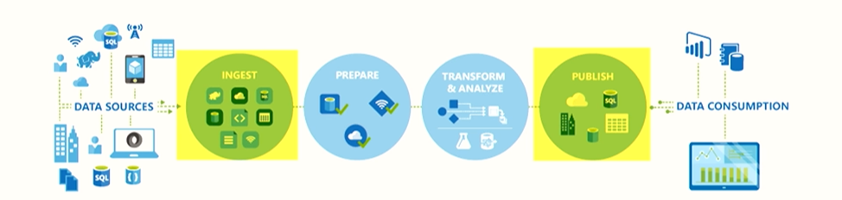
Azure Data Factory
Azure Data Engineering
ETL – ELT Pipeline
SOURCE
SINK

Slide 26
ADF Terminology
Azure Data Engineering
Linked Service
Dedicated Connection to the data store
Dataset
Schema and format of the data to be used in pipeline
Activity
Task to perform on the associated dataset
Pipeline
Sequence / flow of multiple logical activities

Slide 27
DEMO

Slide 28
Introduction to Azure Synapse Analytics
Notes:
Instructor notes
This space has been left deliberately blank

Slide 29
Azure Data Factory
THANK YOU
Email
Maruti_Makwana@hotmail.com

Slide 30
Azure Synapse Spark
Azure Databricks Spark
Pure spark framework with native spark libraries
Spark pool supports isolated compute but does not support GPU based Nodes
Perfect for Big data engineering workloads which integrates with dedicated / serverless SQL pools
Comes with Azure synapse Deltalake 1.2 version and C#
Only available in Azure cloud
Spark framework databricks libraries and dbutils
DB cluster supports GPU based Nodes and special nodes for ML
Perfect for Big Data Engineering with ML and other integrations
Comes with LakeHouse architecture with delta lake
Available in multiple cloud

Slide 31
Azure Synapse pipeline
Azure data factory
Comes with Azure synapse not available separately
Can integrate with both synapse and databricks notebooks
Additional security is available for data and pipeline template integrations
Available separately
Can integrate with databricks notebooks but not with synapse notebooks
Need to integrate with additional security services

